Slide 1
Improving and Probing
Unified Vision-and-language Representation Model
Presented by Liunian Harold Li, Shanxiu He

Slide 2
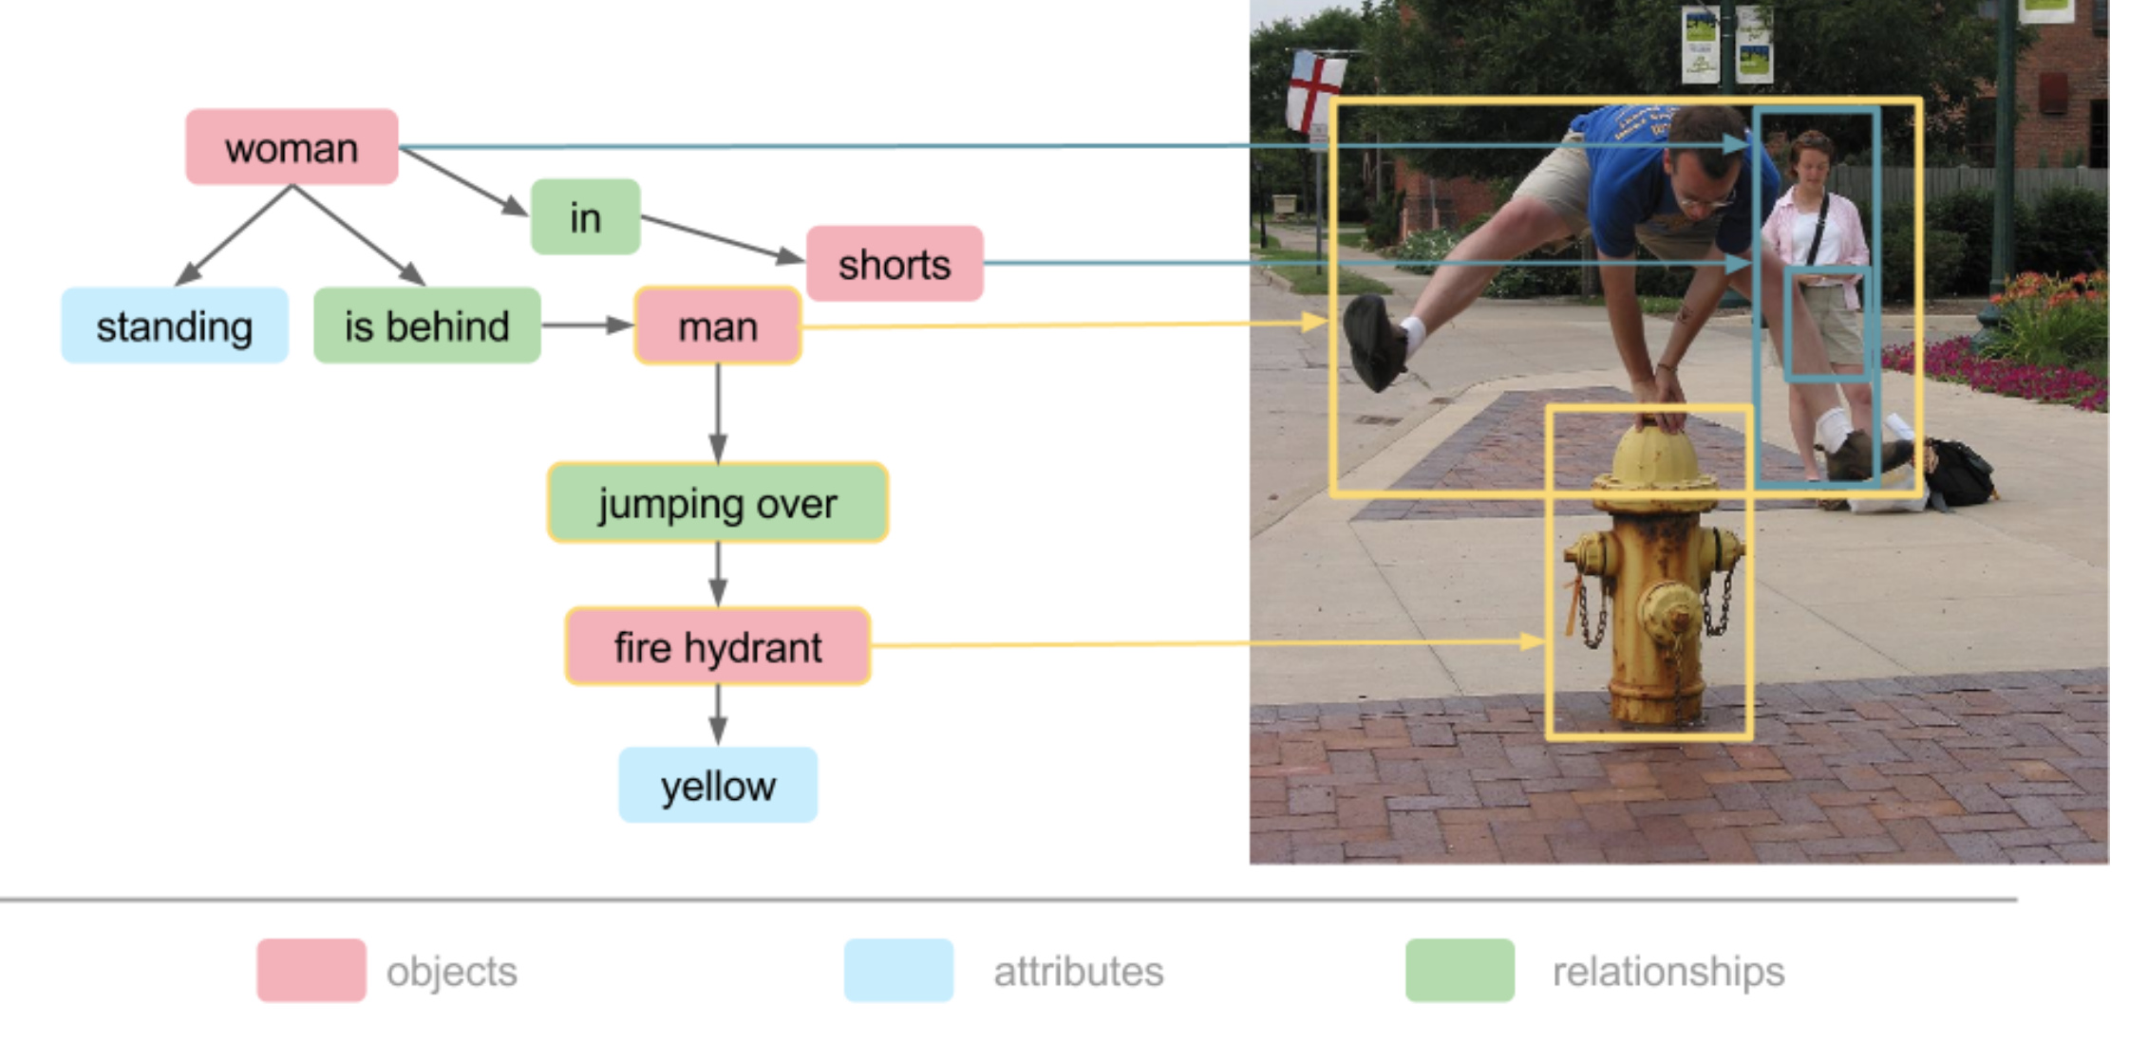
Understand the semantics of an image
Scene Graph:
Objects
Attributes
Relationships
An example scene graph

Slide 3
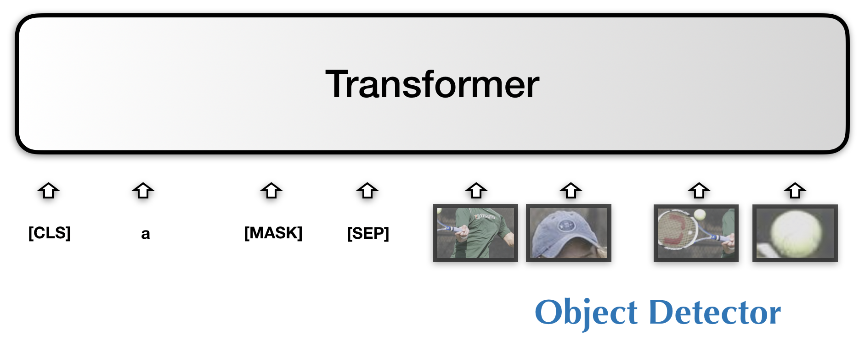
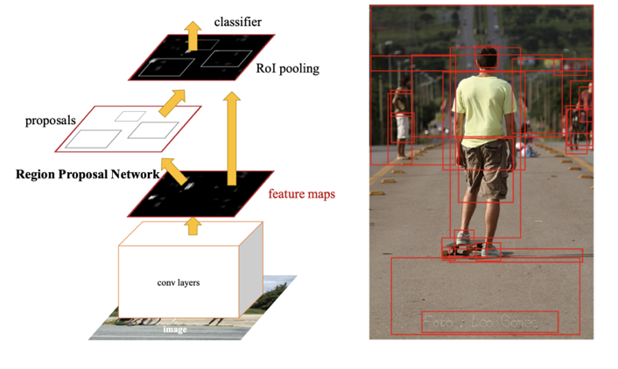
SOTA V&L Models
Scene Graph:
Objects
Attributes
Relationships
VisualBERT, LXMERT, UNITER...

Slide 4
Goal of our project
Improving V&L representation models
Understand V&L representation models
VisualBERT, LXMERT, UNITER...

Slide 5
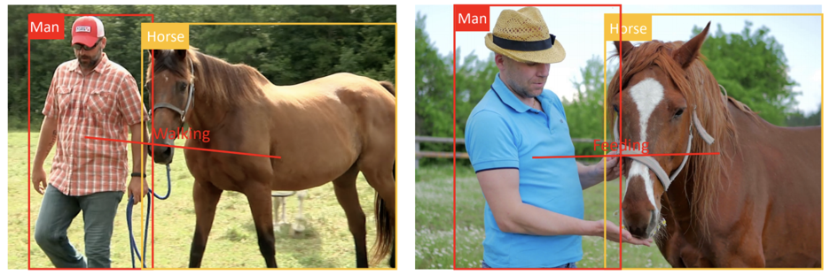
Why current design do not learn visual relationships well?
Man walking a horse
Man feeding a horse
To infer the visual relationship, we need to focus on things
different from when we do object detection

Slide 6
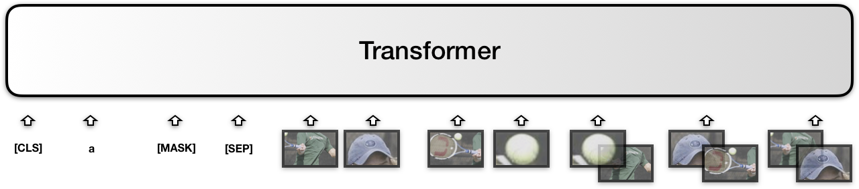
Proposal: Relation-aware VisualBERT
VisualBERT Training Objectives + Relationship Prediction (Sence Graph Generation)
Object-level features
Object-interaction features

Slide 7
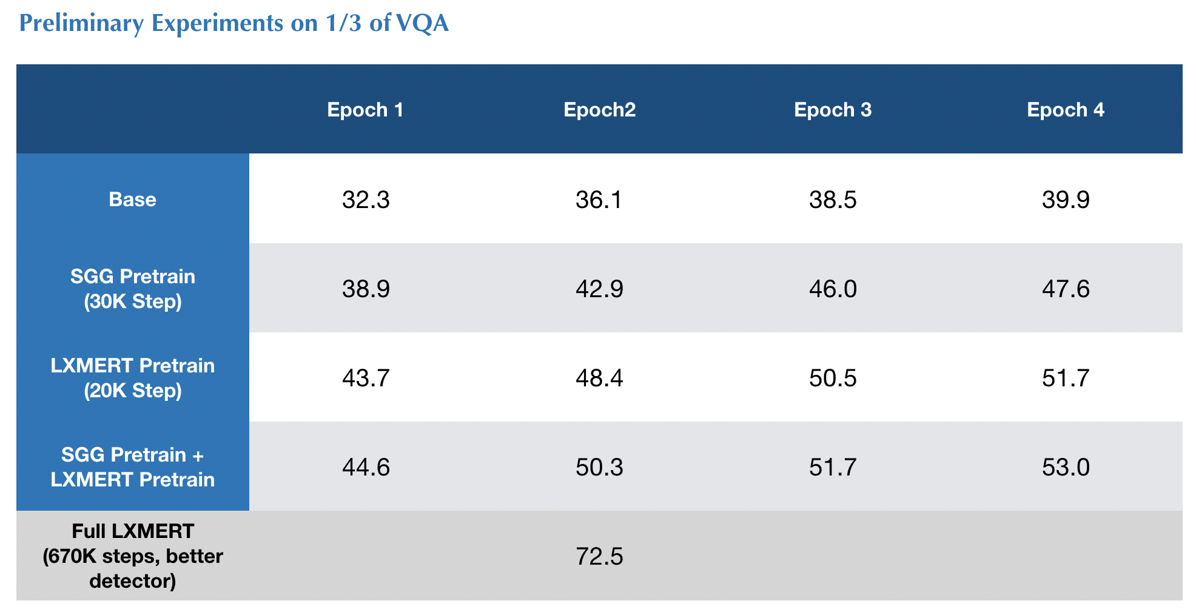
Improving V&L representation models
Performance Improvement by adding object-relationship features and relationship prediction

Slide 8
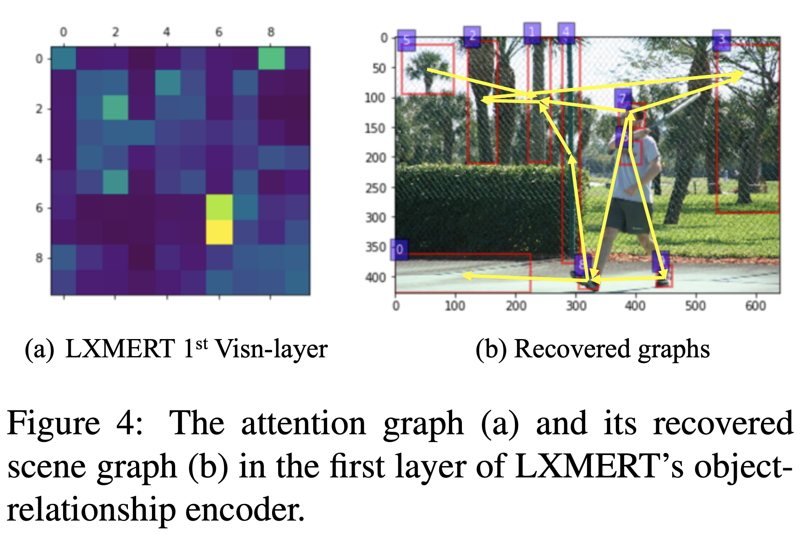
Understand V&L representation models
Probe current V&L models for object, property, and relationship, VisualSRL
Reporting bias in vision, language, and V&L?

Slide 9
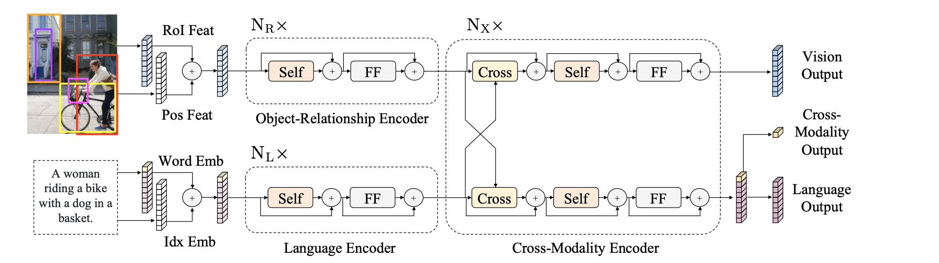
Probing LXMERT Example: Situation Recognition
Key Model: LXMERT
F-RCNN
Model we want to probe!
Figure 5: The LXMERT model for learning vision-and-language cross-modality representations. ‘Self’ and ‘Cross’ are abbreviations for self-attention sub-layers and cross-attention sub-layers, respectively. ‘FF’ denotes a feed-forward sub-layer.
Notes:
sota lxmert: 2 transformers, each for

Slide 10

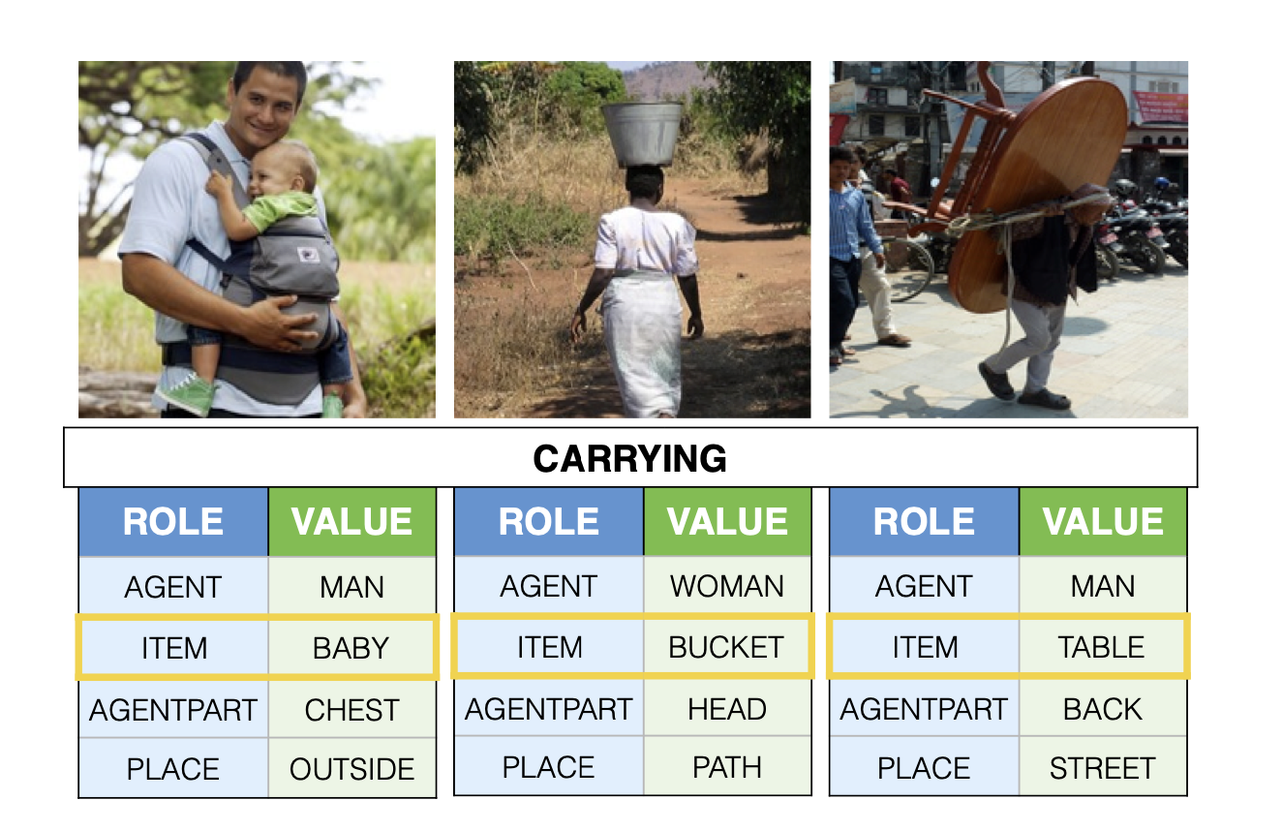
Probing LXMERT Example: Situation Recognition
Task: Situation Recognition
Inspiration: Semantic Role Labeling
(each word is mapped with a frame)
Activity
Object
Role
A boy is fixing a car tire with a tire iron outdoors.
AGENT | OBJECT | PART | TOOL | PLACE
BOY | CAR | TIRE | TIRE IRON | OUTDOORS
Figure 6: Three situations involving carrying, with semantic roles agent, the carrier, item, the carried, agentpart, the part of the agent carrying, and place, where the situation is happening.
Notes:
given a semantic, activity, object, role

Slide 11
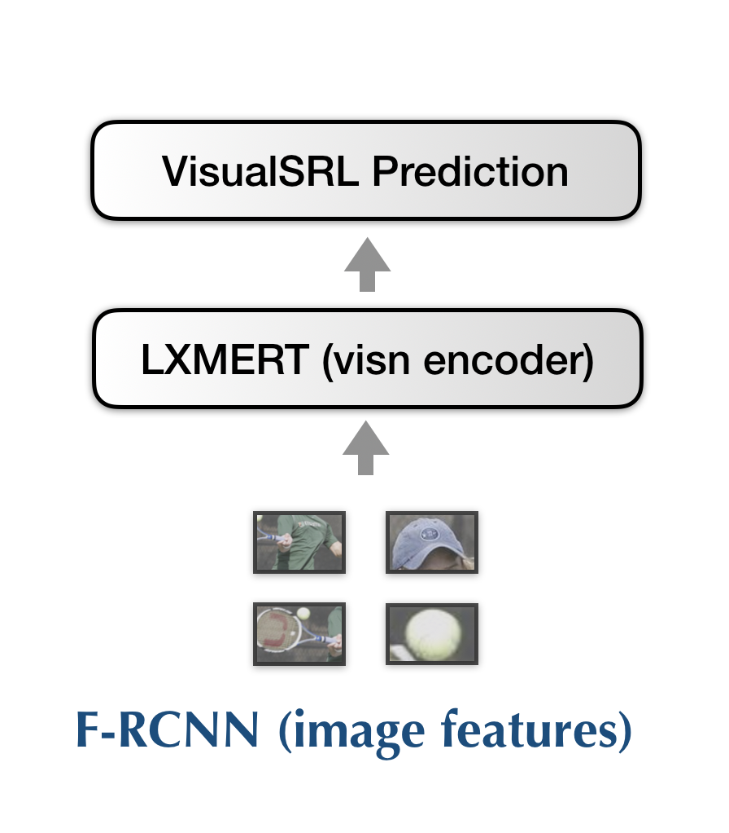
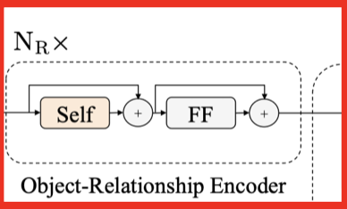
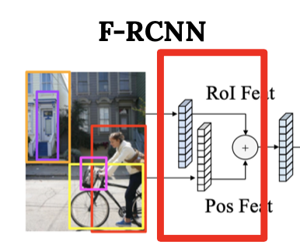
Probing LXMERT Example: Illustrate Visual Semantic Role
Proposal: probing LXMERTs for their visual understanding
To understand the image, we need to understand objects, properties, relations, VisualSRL etc
Method:
1) Extract image features of imSitu with Faster RCNN
2) Feed F-RCNN image features into LXMERT vision object relationship encoder
3) Use LXMERT features to predict VisualSRL
Model we want to probe!

Slide 12
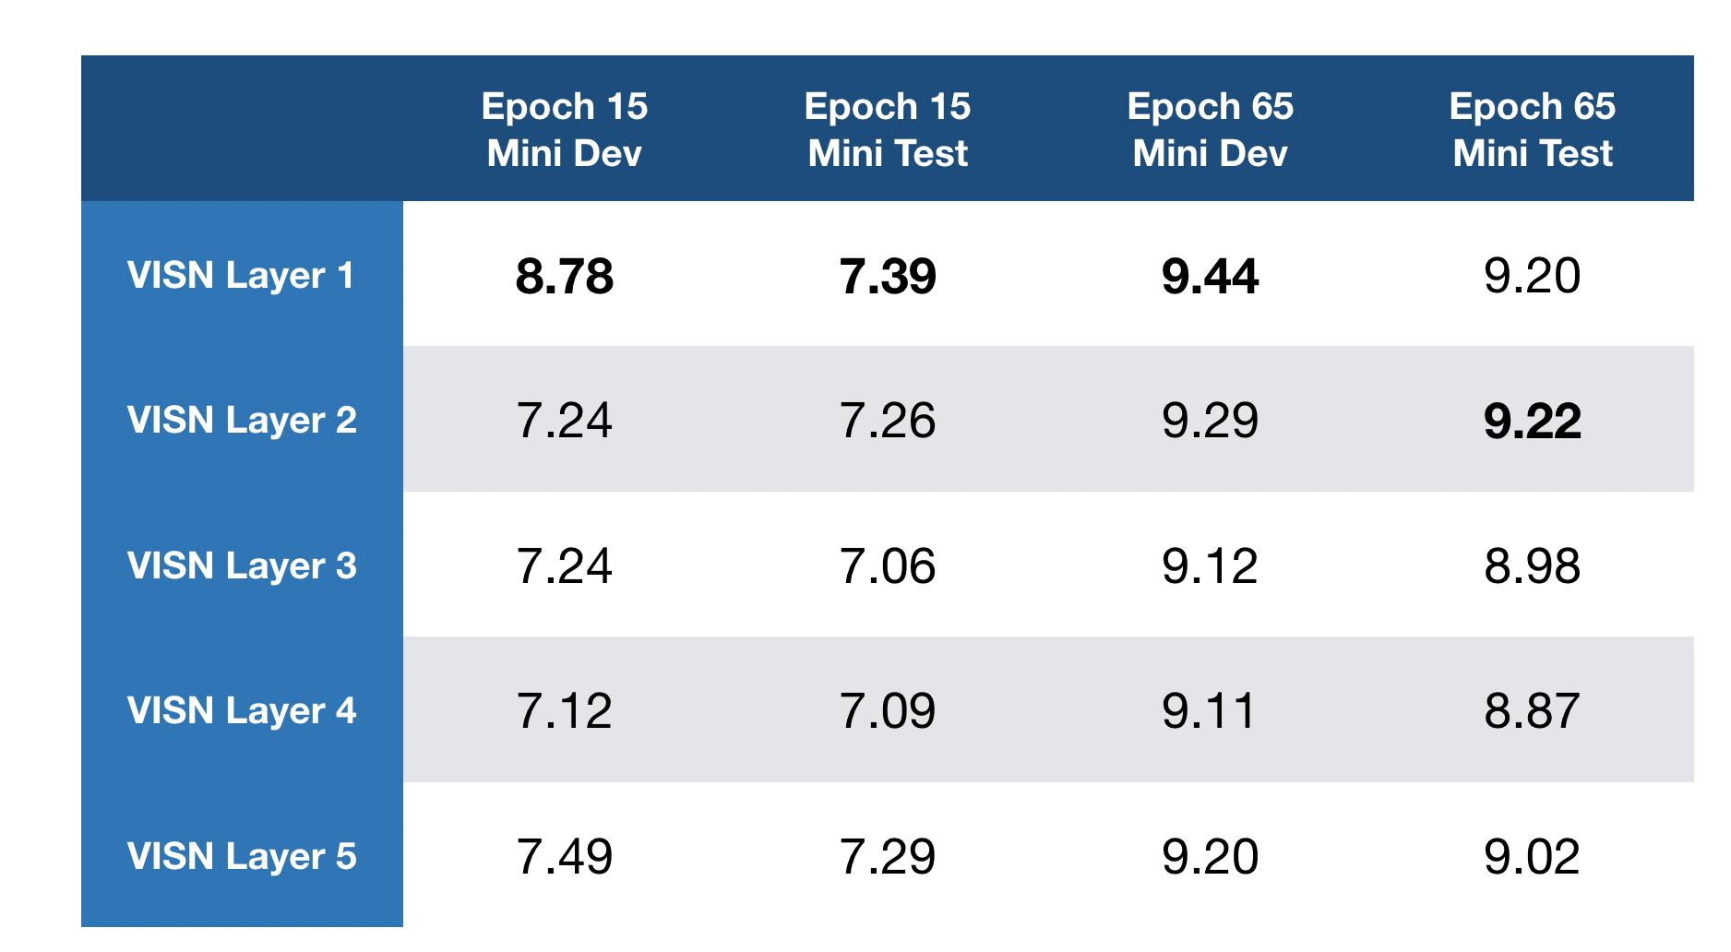
Probing LXMERT Example: Visual Semantic Role
-Performance peaks at 1st layer of “Relationship Encoder”
-Lose information about relationship (semantic role) as the layers go up
Conclusion:
Model has not yet converged (more data is needed)
“Relationship Encoder” of LXMERT fails to demonstrate its ability
Support our claim of adding SGG
Further Improvement:
Extract imSitu dataset (500 activities, 125000 images)
Pre-train LXMERT with imSitu

Slide 13
Thank you!

